Slide 1
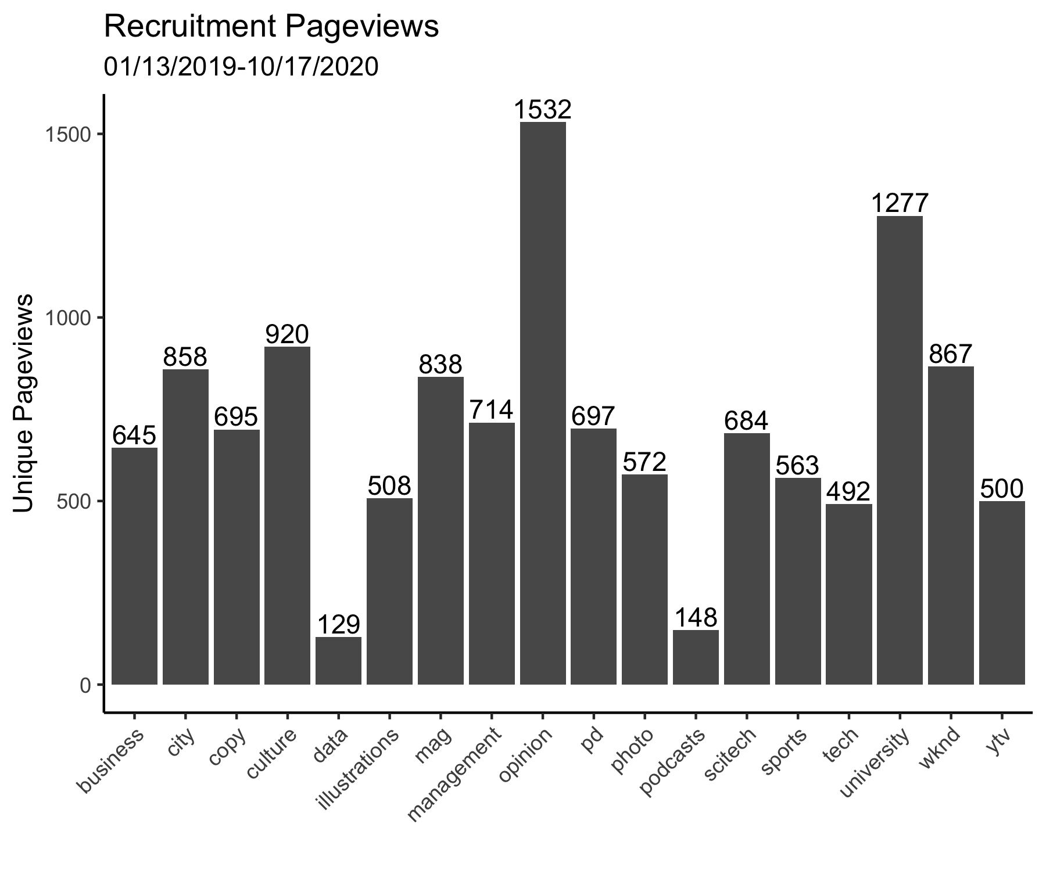

Slide 2
Top 40 Cities by Unique Views of Recruitment Page
1/13/2019-10/17/2020
City | Unique Pageviews
New Haven | 5773
New York | 599
Coffeyville | 201
Cambridge | 111
Chicago | 91
Columbus | 84
San Diego | 77
Bethesda | 71
Washington | 68
Dallas | 67
Plano | 67
Philadelphia | 64
Boston | 58
Princeton | 54
Singapore | 51
Torrance | 51
Lincoln | 49
Seattle | 49
London | 46
City | Unique Pageviews
McLean | 44
Glencoe | 41
Montclair | 40
Los Angeles | 37
Ashburn | 35
Pittsburgh | 35
Melbourne | 34
Palo Alto | 34
Phoenix | 34
Temecula | 34
Duluth | 33
Hartford | 33
Madison | 33
San Jose | 33
Scarsdale | 33
Scottsdale | 32
Las Pinas | 31
Newark | 31
Pasadena | 31

Slide 3
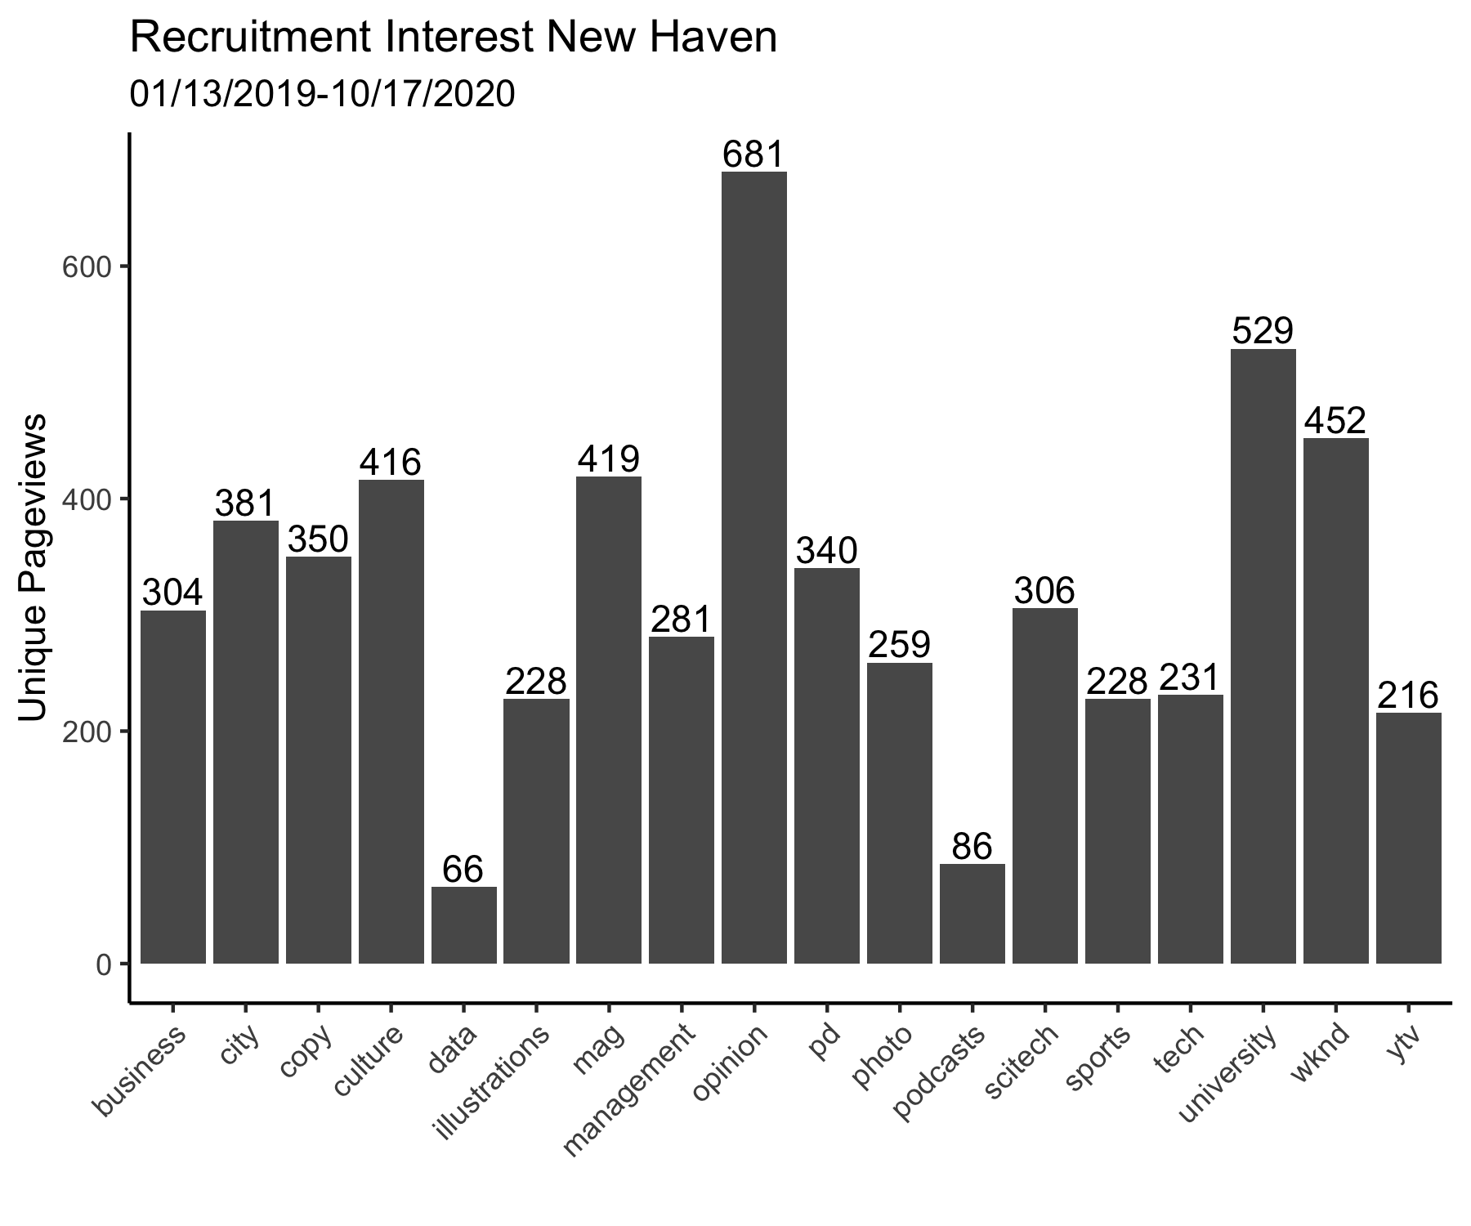

Slide 4
